Slide 1
Melanoma

Slide 2
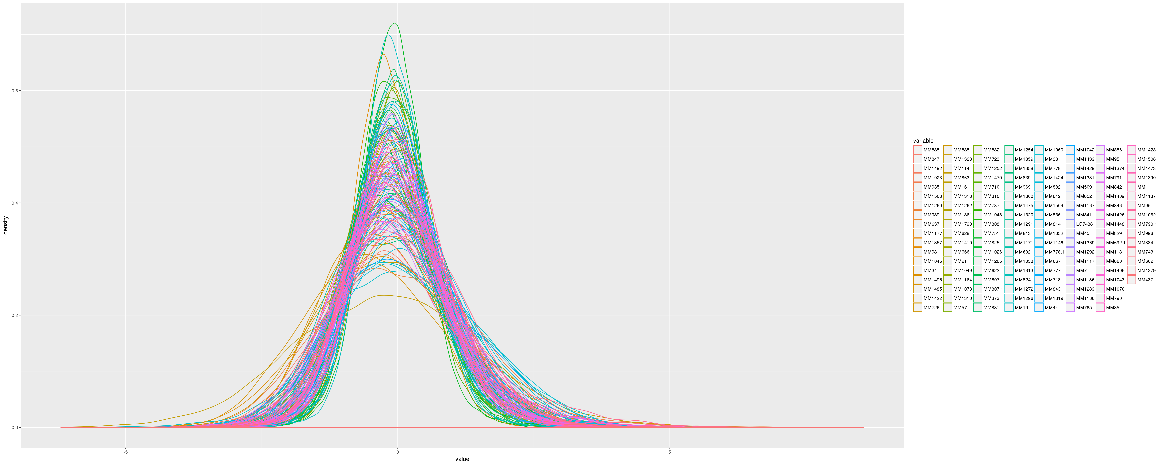
Data

Slide 3
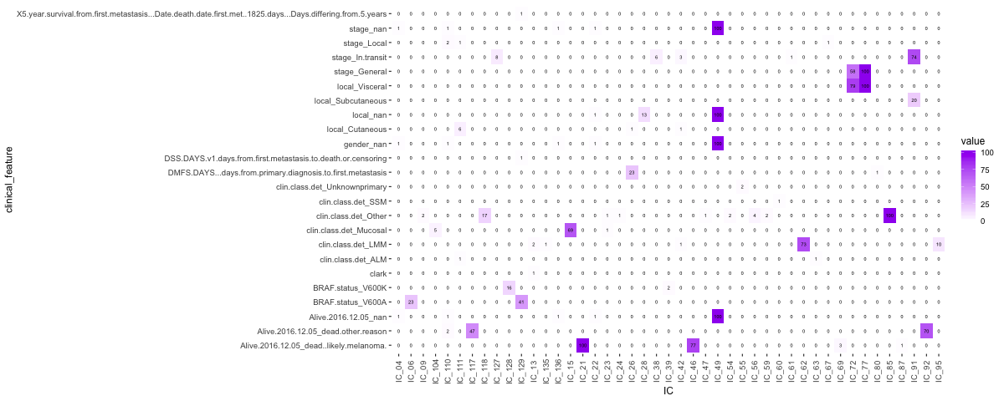
ICA Proteomics (p=0.00005)

Slide 4
Pre-ranked GSEA for each IC (IC-centroid rank)
Heatmap top/bottom ranked genes; clustered with related clinical variable
Reactome pathway database
Adjusted p-value threshold 0.01
5 ICs show significant pathway rankings: Survival related (IC92, IC21, IC117), Stage related (IC77), Clinical_class related (IC118)

Slide 5
IC92

Slide 6
IC21

Slide 7
IC117

Slide 8
IC77

Slide 9
IC118

Slide 10
Core Melanoma Genes from TCGA and others
core_genes = c('BRAF', 'NRAS', 'TP53', 'NF1', 'CDKN2A', 'ARID2', 'PTEN', 'PPP6C', 'RAC1', 'IDH1', 'DDX3X', 'MAP2K1', 'RB1’)
Extended_core_genes = c('BRAF', 'NRAS', 'TP53', 'NF1', 'CDKN2A', 'ARID2', 'PTEN', 'PPP6C', 'RAC1', 'IDH1', 'DDX3X', 'MAP2K1', 'RB1', 'CTNNB1', 'CASP8', 'PCDHGA1', 'SERPINB1', 'IRF7', 'HRAS', 'PTPN11’, 'ITGA4', 'FAM113B', 'MSR1', 'RPS27', 'SIRPB1', 'MRPS31', 'NOTCH2NL', 'KNSTRN', 'ZFX', 'RAPGEFS', 'RCAN2', 'PPIAL4G', 'ACD', 'WDR12', 'COL9A2', 'STK19', 'CCDC28A', 'LRRC37A3', 'OXA1L’, 'NDUFB9', 'EMG1', 'TMEM216', 'RQCD1', 'TBC1D3B', 'GNAI2', 'B2M', 'FAM58A', 'C3orf71')

Slide 11
Core Genes Heatmap (Survival clustered)

Slide 12
Survival Analysis (Keplan Meier)
3 survival measures (days from primary, metastasis, and sample collection)
Core-genes-extended, IC21, IC92, IC117, BRAF
K-means clustered to 2 groups (except BRAF)
For each core-genes, t-test for survival measures

Slide 13
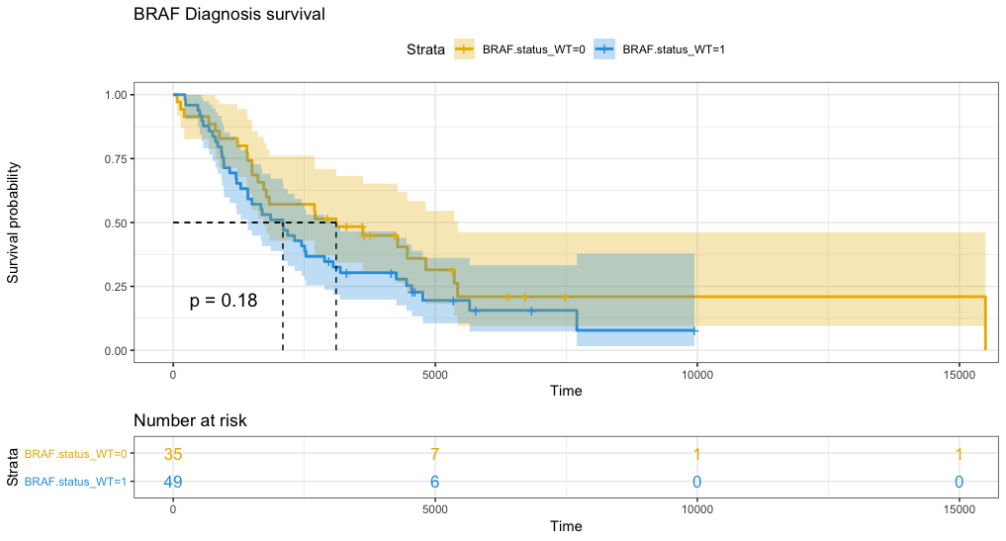
Good Examples

Slide 14
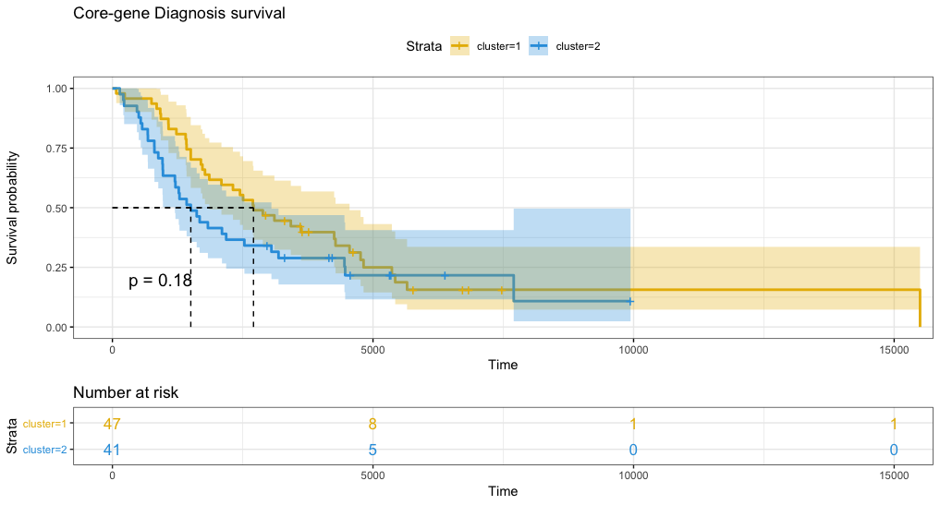

Slide 15
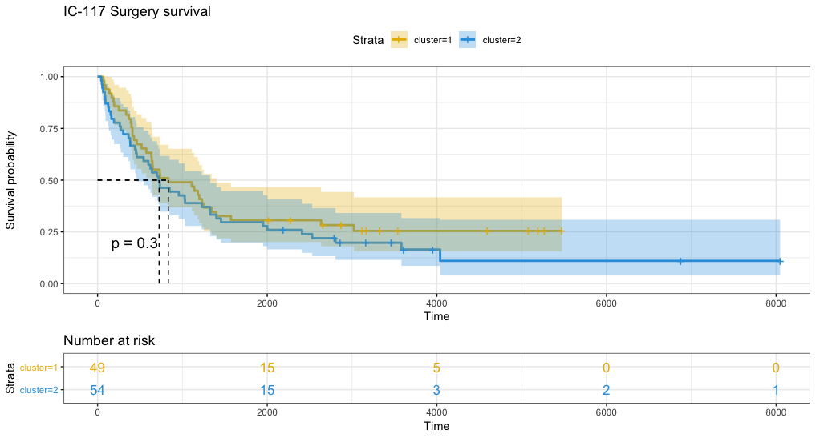

Slide 16
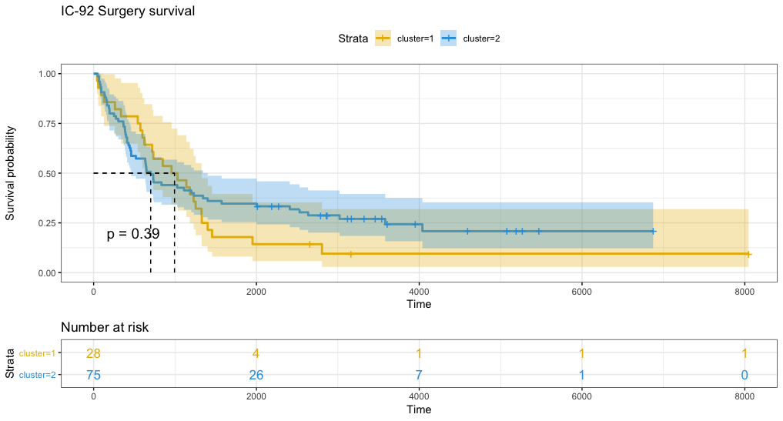

Slide 17
T-tests
 | T-Test p-value
MRPS31 | 0.00850524
CDKN2A | 0.01696789
MAP2K1 | 0.02688536
DDX3X | 0.03398221
NF1 | 0.03879164
NDUFB9 | 0.04322214
Overall | 0.04521929
OXA1L | 0.08091494
IDH1 | 0.11360148
CCDC28A | 0.1290767
ARID2 | 0.16437213
SERPINB1 | 0.18180528
B2M | 0.31524288
CTNNB1 | 0.38173286
NRAS | 0.4486981
MSR1 | 0.59880321
PTEN | 0.62985826
WDR12 | 0.63906052
ITGA4 | 0.72702376
PPP6C | 0.77181581
GNAI2 | 0.7857312
RPS27 | 0.85590101
EMG1 | 0.91518631
RAC1 | 0.97008706
BRAF | 0.97598416
RB1 | 0.99126555
 | T-Test p-value
CTNNB1 | 0.00622383
MAP2K1 | 0.0260903
GNAI2 | 0.0617671
MRPS31 | 0.06800714
ITGA4 | 0.08078683
CDKN2A | 0.0945774
SERPINB1 | 0.14370876
BRAF | 0.17631893
B2M | 0.25352046
WDR12 | 0.31693145
IDH1 | 0.37064847
DDX3X | 0.40738564
ARID2 | 0.41476319
NDUFB9 | 0.41658442
PTEN | 0.43428318
RAC1 | 0.45302085
Overall | 0.46487202
CCDC28A | 0.49969779
RB1 | 0.54865271
OXA1L | 0.60686488
EMG1 | 0.67986685
NRAS | 0.73362422
MSR1 | 0.74268602
RPS27 | 0.78981662
PPP6C | 0.94326691
NF1 | 0.9600614
5YR-survival binary
Cut-off day-survival binary

Slide 18
Other Categorical Features with Core Genes
dis_stage, prim_Breslow_class, clark, clin_class, prim_site, BRAF
ANOVA test

Slide 19
dis_stage
 | ANOVA p-value
GNAI2 | 0.0038426
B2M | 0.00713155
SERPINB1 | 0.04961819
NRAS | 0.05254436
RAC1 | 0.09160301
MSR1 | 0.12349752
MRPS31 | 0.17242788
PTEN | 0.18562426
DDX3X | 0.29507445
NDUFB9 | 0.31582559
RB1 | 0.32721213
ITGA4 | 0.33973113
BRAF | 0.34038236
NF1 | 0.37800581
MAP2K1 | 0.39861624
IDH1 | 0.53190492
EMG1 | 0.59433522
WDR12 | 0.69502799
RPS27 | 0.76383661
PPP6C | 0.80663455
CDKN2A | 0.80915553
CCDC28A | 0.81665719
ARID2 | 0.85413102
CTNNB1 | 0.90783151
OXA1L | 0.95359264

Slide 20
prim_Breslow_class
 | ANOVA p-value
CTNNB1 | 0.0030094
NDUFB9 | 0.10906832
ARID2 | 0.11823493
RB1 | 0.15097705
DDX3X | 0.1518982
MSR1 | 0.18995048
CCDC28A | 0.19044818
NF1 | 0.21586891
PTEN | 0.23408581
ITGA4 | 0.25392776
IDH1 | 0.28190156
CDKN2A | 0.28760815
RAC1 | 0.41331799
PPP6C | 0.42031455
MAP2K1 | 0.42148726
EMG1 | 0.42504578
NRAS | 0.45274661
WDR12 | 0.49200584
MRPS31 | 0.58466233
BRAF | 0.60304615
B2M | 0.74678889
OXA1L | 0.78412401
RPS27 | 0.89332804
GNAI2 | 0.89695831
SERPINB1 | 0.9456852

Slide 21
clark
 | ANOVA p-value
CTNNB1 | 0.01699557
EMG1 | 0.07906005
RB1 | 0.11902849
ARID2 | 0.14102274
ITGA4 | 0.20416915
MSR1 | 0.22829335
MRPS31 | 0.23658502
NF1 | 0.2954258
B2M | 0.32102384
WDR12 | 0.3664813
NRAS | 0.41516229
OXA1L | 0.53415381
NDUFB9 | 0.57262735
DDX3X | 0.61906031
PPP6C | 0.6397696
BRAF | 0.66731522
PTEN | 0.67984727
RPS27 | 0.77883261
CDKN2A | 0.7833261
MAP2K1 | 0.79037558
SERPINB1 | 0.79609895
GNAI2 | 0.81987216
RAC1 | 0.86389336
IDH1 | 0.8908515
CCDC28A | 0.91555537

Slide 22
clin_class
 | ANOVA p-value
CDKN2A | 0.01883906
NF1 | 0.0223456
MSR1 | 0.09893619
RB1 | 0.10899784
MRPS31 | 0.12290525
ARID2 | 0.1979794
BRAF | 0.2545312
PTEN | 0.26087101
PPP6C | 0.31309161
MAP2K1 | 0.34716426
OXA1L | 0.34805322
DDX3X | 0.37006511
ITGA4 | 0.39632809
CTNNB1 | 0.51906678
IDH1 | 0.52843153
RPS27 | 0.55842075
SERPINB1 | 0.58947525
CCDC28A | 0.63538649
NRAS | 0.66798554
NDUFB9 | 0.72236501
GNAI2 | 0.74440038
RAC1 | 0.78932526
EMG1 | 0.94775634
B2M | 0.96119472
WDR12 | 0.96412076

Slide 23
prim_site
 | ANOVA p-value
ARID2 | 0.03205796
MAP2K1 | 0.24068649
RAC1 | 0.26747449
B2M | 0.29140914
IDH1 | 0.31513446
RB1 | 0.35002324
NF1 | 0.36030561
CDKN2A | 0.39905784
EMG1 | 0.46541815
MSR1 | 0.49039905
BRAF | 0.52677729
MRPS31 | 0.61118111
SERPINB1 | 0.64382246
OXA1L | 0.68221519
PTEN | 0.68349068
PPP6C | 0.75332957
CCDC28A | 0.76585021
ITGA4 | 0.77620375
WDR12 | 0.82004202
GNAI2 | 0.84173494
RPS27 | 0.93263473
CTNNB1 | 0.94892905
NDUFB9 | 0.96145854
NRAS | 0.96660314
DDX3X | 0.98037157

Slide 24
BRAF
 | T-Test p-value
PPP6C | 0.08153551
NRAS | 0.09276454
MAP2K1 | 0.12239076
IDH1 | 0.13738533
Overall | 0.13923268
B2M | 0.1445405
BRAF | 0.16130362
CCDC28A | 0.21799359
NF1 | 0.25974169
PTEN | 0.2904473
SERPINB1 | 0.3340633
RB1 | 0.34686458
ARID2 | 0.43106936
ITGA4 | 0.45633033
GNAI2 | 0.46143403
CTNNB1 | 0.51893687
MSR1 | 0.52206293
NDUFB9 | 0.6819319
DDX3X | 0.68491876
CDKN2A | 0.69371946
MRPS31 | 0.79781648
WDR12 | 0.82071733
RPS27 | 0.8808763
EMG1 | 0.89752859
RAC1 | 0.95027192
OXA1L | 0.97386363

